Slide 1
Storing data with Room
Advanced Android Development V2
Lesson 10

Slide 2

10.1 Room, LiveData, and ViewModel

Slide 3
Contents
Architecture Components
Entity
DAO
Room database
ViewModel
Repository
LiveData
Lifecycle

Slide 4
Architecture Components

Slide 5

Architecture Components
A set of Android libraries for structuring your app in a way that is robust, testable, and maintainable.

Slide 6
Architecture Components
Consist of best architecture practices + libraries
Encourage recommended app architecture
A LOT LESS boilerplate code
Testable because of clear separation
Fewer dependencies
Easier to maintain

Slide 7
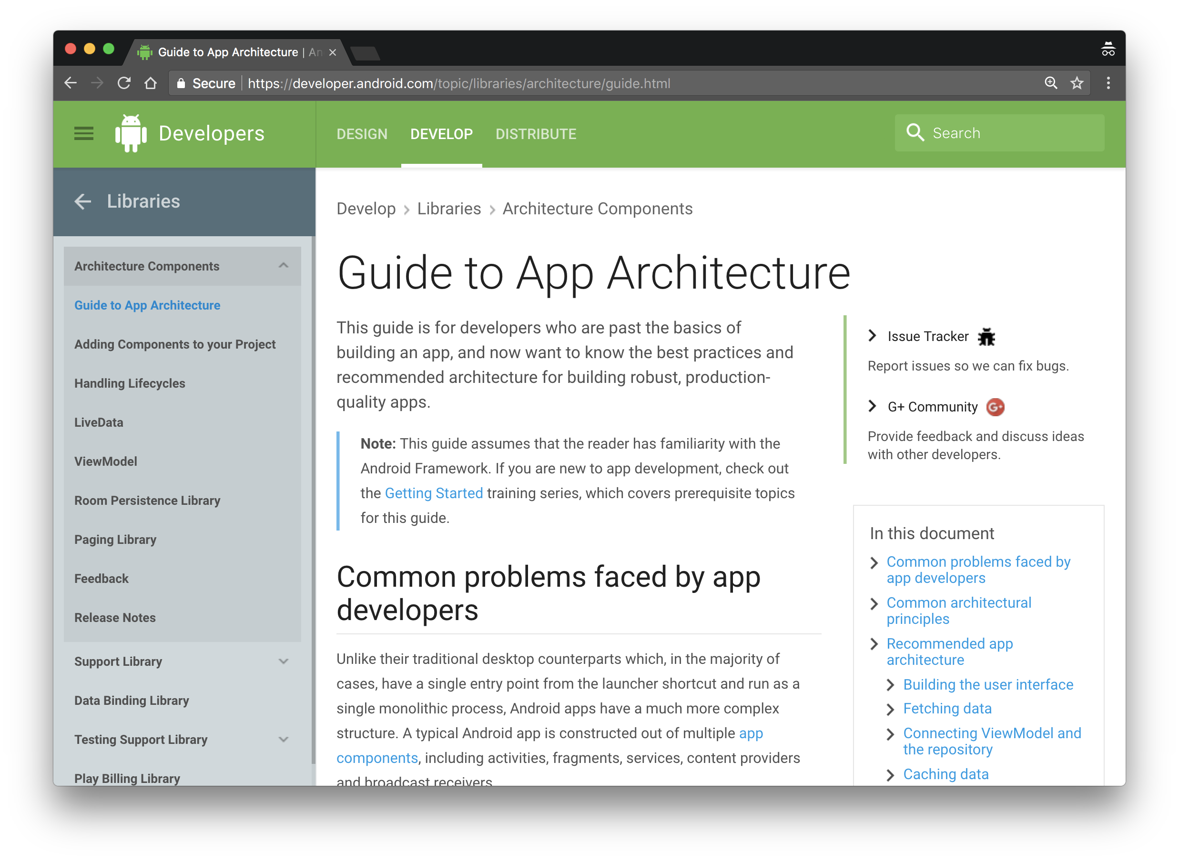
Guide to app architecture
developer.android.com/arch

Slide 8
Overview
UI Controller
(activity/fragment)
Displays data and forwards on UI events
UI is notified of changes using observation
ViewModel
Holds all the data needed for the UI
LiveData
LiveData
LiveData
Single source of truth for all app data; clean API for UI to communicate with
Repository
RoomDatabase
LiveData
LiveData
Manages local data SQLite data source, using objects
Entity
SQLite
DAO

Slide 9
MainActivity
NewWordActivity
Observer
WordListAdapter
The RoomWordsSample app that you build in the practical implements this architecture
WordViewModel
LiveData<List<Word>>
WordRepository
Room
WordRoomDatabase
Word
SQLite
WordDao

Slide 10
Room overview

Slide 11

Room overview
Room is a robust SQL object mapping library
Generates SQLite Android code
Provides a simple API for your database

Slide 12
Components of Room
Entity: Defines schema of database table.
DAO: Database Access Object Defines read/write operations for database.
Database: A database holder. Used to create or connect to database
RoomDatabase
LiveData
LiveData
Entity
SQLite
DAO

Slide 13
Entity

Slide 14
Entity
public class Person {
private int uid;
private String firstName;
private String lastName;
}
Entity instance = row in a database table
Define entities as POJO classes
1 instance = 1 row
Member variable = column name
RoomDatabase
LiveData
LiveData
Entity
SQLite
DAO

Slide 15
Entity instance = row in a database table
public class Person {
private int uid;
private String firstName;
private String lastName;
}
uid | firstName | lastName
12345 | Aleks | Becker
12346 | Jhansi | Kumar

Slide 16
Annotate entities
@Entity
public class Person {
@PrimaryKey (autoGenerate=true)
private int uid;
@ColumnInfo(name = "first_name")
private String firstName;
@ColumnInfo(name = "last_name")
private String lastName;
// + getters and setters if variables are private.
}

Slide 17
@Entity annotation
@Entity(tableName = "word_table")
Each @Entity instance represents an entity/row in a table
Specify the name of the table if different from class name

Slide 18

@PrimaryKey annotation
@PrimaryKey (autoGenerate=true)
Entity class must have a field annotated as primary key
You can auto-generate unique key for each entity
See Defining data using Room entities

Slide 19

@NonNull annotation
@NonNull
Denotes that a parameter, field, or method return value can never be null
Use for mandatory fields
Primary key must use @NonNull

Slide 20


@ColumnInfo annotation
@ColumnInfo(name = "first_name")
private String firstName;
@ColumnInfo(name = "last_name")
private String lastName;
Specify column name if different from member variable name
first_name
last_name

Slide 21

Getters, setters
Every field that's stored in the database must
be public
OR
have a "getter" method
… so that Room can access it

Slide 22

Relationships
users table
Use @Relation annotation to define related entities
Queries fetch all the returned object's relations
id
name
pet
pets table
id
name
owner
Notes:
Relationship example:
User and Pet, where Pet is its own object
Don't go into detail, the main point is that Room supports relationships

Slide 23
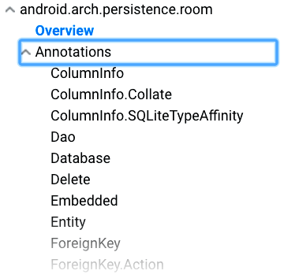
Many more annotations
For more annotations, see Room package summary reference

Slide 24
Data access object (DAO)

Slide 25
Data access object
Use data access objects, or DAOs, to access app data using the Room persistence library
RoomDatabase
LiveData
LiveData
Entity
SQLite
DAO

Slide 26
Data access object
DAO methods provide abstract access to the app's database
The data source for these methods are entity objects
DAO must be interface or abstract class
Room uses DAO to create a clean API for your code

Slide 27
Example DAO
@Dao
public interface WordDao {
@Insert
void insert(Word word);
@Update
public void updateWords(Word... words);
}
//... More queries on next slide...

Slide 28
Example queries
@Query("DELETE FROM word_table")
void deleteAll();
@Query("SELECT * from word_table ORDER BY word ASC")
List<Word> getAllWords();
@Query("SELECT * FROM word_table WHERE word LIKE :word ")
public List<Word> findWord(String word);

Slide 29
Room database

Slide 30
Room
Room is a robust SQL object mapping library
Generates SQLite Android code

Slide 31
Room
Room works with DAO and Entities
Entities define the database schema
DAO provides methods to access database
RoomDatabase
LiveData
LiveData
Entity
SQLite
DAO

Slide 32
Creating Room database
Create public abstract class extending RoomDatabase
Annotate as @Database
Declare entities for database schema and set version number
@Database(entities = {Word.class}, version = 1)
public abstract class WordRoomDatabase extends RoomDatabase

Slide 33

Room class example
Entity defines
DB schema
@Database(entities = {Word.class}, version = 1)
public abstract class WordRoomDatabase
extends RoomDatabase {
public abstract WordDao wordDao();
private static WordRoomDatabase INSTANCE;
// ... create instance here
}
DAO for database
Create database as singleton instance

Slide 34
Use Database builder
Use Room's database builder to create the database
Create DB as singleton instance
private static WordRoomDatabase INSTANCE;
INSTANCE = Room.databaseBuilder(...)
.build();

Slide 35
Specify database class and name
Specify Room database class and database name
INSTANCE = Room.databaseBuilder(
context,
WordRoomDatabase.class, "word_database")
//...
.build();

Slide 36
Specify onOpen callback
Specify onOpen callback
INSTANCE = Room.databaseBuilder(
context,
WordRoomDatabase.class, "word_database")
.addCallback(sOnOpenCallback)
//...
.build();

Slide 37
Specify migration strategy
Specify migration strategy callback
INSTANCE = Room.databaseBuilder(
context.getApplicationContext(),
WordRoomDatabase.class, "word_database")
.addCallback(sOnOpenCallback)
.fallbackToDestructiveMigration()
.build();

Slide 38

Room database creation example
static WordRoomDatabase getDatabase(final Context context) {
if (INSTANCE == null) {
synchronized (WordRoomDatabase.class) {
if (INSTANCE == null) {
INSTANCE = Room.databaseBuilder(
context.getApplicationContext(),
WordRoomDatabase.class, "word_database")
.addCallback(sOnOpenCallback)
.fallbackToDestructiveMigration()
.build();
}}}
return INSTANCE;
}
Check if database exists before creating it

Slide 39
Initialize DB in onOpen callback
private static RoomDatabase.Callback sOnOpenCallback =
new RoomDatabase.Callback(){
@Override
public void onOpen (@NonNull SupportSQLiteDatabase db){
super.onOpen(db);
initializeData();
}};

Slide 40
Room caveats
Compile-time checks of SQLite statements
Do not run database operations on the main thread
LiveData automatically runs query asynchronously on a background thread when needed
Usually, make your RoomDatabase a singleton
Notes:
we will discuss LiveData soon

Slide 41
ViewModel

Slide 42
ViewModel
View models are objects that provide data for UI components and survive configuration changes.
ViewModel
LiveData
LiveData
LiveData

Slide 43
ViewModel
Provides data to the UI
Survives configuration changes
You can also use a ViewModel to share data between fragments
Part of the lifecycle library

Slide 44



Survives configuration changes
Activity Instance
ViewModel
Rotation Event
Activity UI Data
Re-created Activity Instance

Slide 45

ViewModel serves data
ViewModel serves data to the UI
Data can come from Room database or other sources
ViewModel's role is to return the data, it can get help to find or generate the data
Notes:
Here we see a server "serving" up the salad that the customer requested. View models serve up the data that is requested

Slide 46

Best practice to use repository
Recommended best practice:
Use a repository to do the work to get the data
Keeps ViewModel as clean interface between app and data
Repository is discussed in next section
Notes:
Here we see the kitchen staff preparing the salad behind the scenes. The repository does the work of getting the data behind in the background

Slide 47
Restaurant analogy
Customer requests meal from server
Server takes order to chefs
Chefs prepare meal
Server delivers meal to customer
UI requests data from ViewModel
ViewModel asks Repository for data
Repository gets data
ViewModel returns data to UI
Notes:
using a repository keeps the functionality of who does what very clean -- ViewModel "serves" data, but doesn't necessarily have to go find it
Task separation

Slide 48
ViewModel example using repository
public class WordViewModel extends AndroidViewModel {
private WordRepository mRepository;
private LiveData<List<Word>> mAllWords;
// Initialize the repository and the list of words
public WordViewModel (Application application) {
super(application);
mRepository = new WordRepository(application);
mAllWords = mRepository.getAllWords();
}

Slide 49
ViewModel example continued
LiveData<List<Word>> getAllWords() {
return mAllWords;
}
public void insert(Word word) {
mRepository.insert(word);
}
public void deleteWord(Word word) {
mRepository.deleteWord(word);
}

Slide 50
Do not pass context into ViewModel
Never pass context into ViewModel instances
Do not store Activity, Fragment, or View instances or their Context in the ViewModel
An Activity can be destroyed and created many times during the lifecycle of a ViewModel
If you need application context, inherit from AndroidViewModel

Slide 51
ViewModel does not survive app closure
ViewModel survives configuration changes, not app shutdown
ViewModel is not a replacement for onSaveInstanceState() (if you are not saving the data with Room)
See Saving UI States
Notes:
In the practicals, you use ViewModel with Room. However, you can use ViewModel without Room; the goal of ViewModel is to provide data to the UI. If that data changes and the app quits, the changed data is lost if you don't save it somehow.

Slide 52
Repository

Slide 53
Repository
Best practice, not part of Architecture Components libraries
Implement repository to provide single, clean API to app data
Repository

Slide 54
Repository fetches or generates data
Use repository to fetch data in the background
Analogy: chefs prepare meals behind the scenes
Notes:
analogy: if meals are already plated, fetch a plated meal, otherwise create the meal from scratch

Slide 55
Multiple backends
Repository
Potentially, repository could manage query threads and allow you to use multiple backends
Example: in Repository, implement logic for deciding whether to fetch data from a network or use results cached in the database
Dao
Network
Notes:
analogy: if meals are already plated, fetch a plated meal, otherwise create the meal from scratch

Slide 56
Repository example
public class WordRepository {
private WordDao mWordDao;
private LiveData<List<Word>> mAllWords;
WordRepository(Application application) {
WordRoomDatabase db = WordRoomDatabase.getDatabase(application);
mWordDao = db.wordDao();
mAllWords = mWordDao.getAllWords();
}
[... more code…]
}

Slide 57
Get and insert data
LiveData<List<Word>> getAllWords() {
return mAllWords;
}
// Must insert data off the main thread
public void insert (Word word) {
new insertAsyncTask(mWordDao).execute(word);
}
[... more code…]
}

Slide 58
Insert off main thread
private static class insertAsyncTask extends AsyncTask
<Word, Void, Void> {
private WordDao mAsyncTaskDao;
insertAsyncTask(WordDao dao) {
mAsyncTaskDao = dao;
}
@Override
protected Void doInBackground(final Word... params) {
mAsyncTaskDao.insert(params[0]);
return null;
}
}

Slide 59
LiveData

Slide 60
LiveData
LiveData
LiveData is a data holder class that is aware of lifecycle events. It keeps a value and allows this value to be observed.
ViewModel
LiveData
LiveData
LiveData
Use LiveData to keep your UI up to date with the latest and greatest data.

Slide 61

LiveData
LiveData is observable data
Notifies observer when data changes
Is lifecycle aware:
knows when device rotates or app stops

Slide 62

Use LiveData to keep UI up to date
Create an observer that observes the LiveData
LiveData notifies Observer objects when the observed data changes
Your observer can update the UI every time the data changes

Slide 63
Creating LiveData
To make data observable, return it as LiveData:
@Query("SELECT * from word_table)
LiveData<List<Word>> getAllWords();

Slide 64


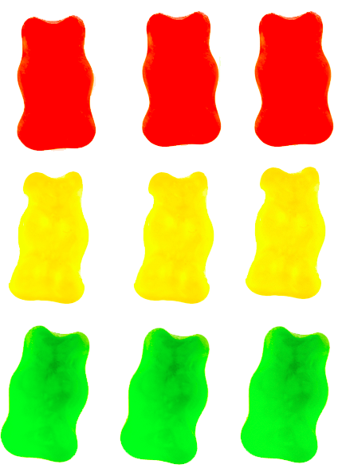
Using LiveData with Room
Room generates all the code to update the LiveData when the database is updated

Slide 65
Passing LiveData through layers
When you pass live data through the layers of your app architecture, from a Room database to your UI, that data must be LiveData in all layers:
DAO
ViewModel
Repository

Slide 66
Passing LiveData through layers
DAO:
@Query("SELECT * from word_table")
LiveData<List<Word>> getAllWords();
Repository:
LiveData<List<Word>> mAllWords = mWordDao.getAllWords();
ViewModel:
LiveData<List<Word>> mAllWords = mRepository.getAllWords();

Slide 67
Observing LiveData
Create the observer in onCreate() in the Activity
Override onChanged() in the observer to update the UI when the data changes
When the LiveData changes, the observer is notified and its onChanged() is executed

Slide 68
Observing LiveData: example
final Observer<String> nameObserver =
new Observer<String>() {
@Override
public void onChanged(@Nullable final String newName) {
// Update the UI, in this case, a TextView.
mNameTextView.setText(newName);
}
};
mModel.getCurrentName().observe(this, nameObserver);

Slide 69
No memory leaks
Observers are bound to Lifecycle objects which are objects that have an Android Lifecycle
Observers clean up after themselves when their associated lifecycle is destroyed

Slide 70
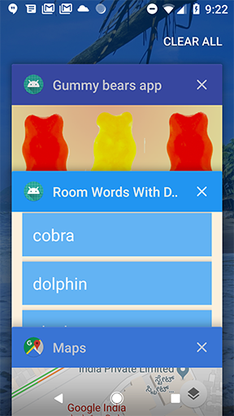
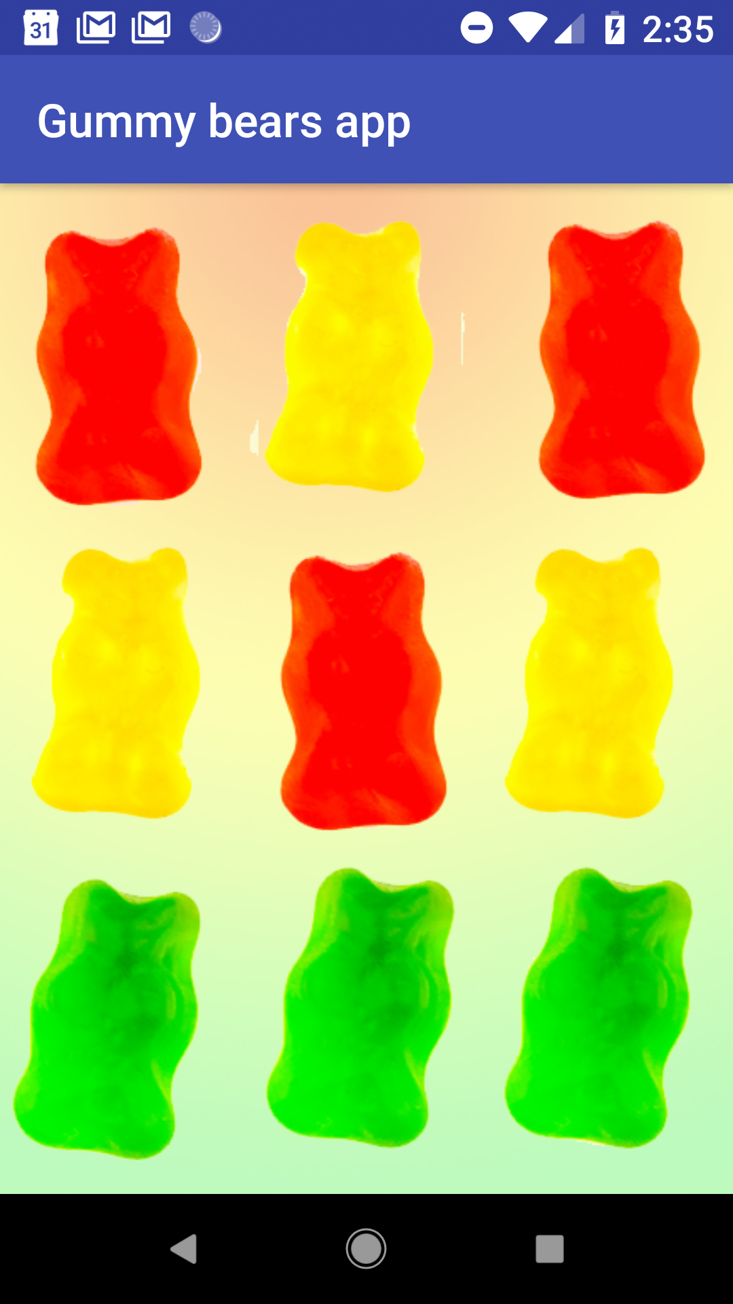
LiveData is always up to date
If a lifecycle object becomes inactive, it gets the latest data when it becomes active again
Example: an activity in the background gets the latest data right after it returns to the foreground

Slide 71
LiveData handles configuration changes
If an activity or fragment is re-created due to a configuration change such as device rotation, the activity or fragment immediately receives the latest available data

Slide 72
Share resources
You can extend a LiveData object using the singleton pattern, for example for services or a database
The LiveData object connects to the system service once, and then any observer that needs the resource can just watch the LiveData object
See Extend LiveData

Slide 73
Lifecycle
Notes:
Best to take a break before starting the Lifecycle slides. There is no practical for Lifecycle. But this is a very long deck, and the Lifecycle topic is different (though related) to the previous topics in this deck.

Slide 74
Lifecycle-aware components
Instead of managing lifecycle-dependent components in the activity's lifecycle methods, onStart(), onStop(), and so on, you can make any class react to lifecycle events
Notes:
Using lifecycle objects helps define roles and responsibilities where they belong. Instead of the activity or fragment being responsible for cleaning up or changing things for everybody at different lifecycle stages, the relevant components do it themselves.
For example, when lunch at school is over, each student cleans up their own plate. The cook doesn't have to come out and clean up after each student, the students do it themselves.

Slide 75
Lifecycle-aware components
Lifecycle-aware components perform actions in response to a change in the lifecycle status of another component
For example, a listener could start and stop itself in response to an activity starting and stopping

Slide 76
Use cases
Switch between coarse and fine-grained location updates depending on app visibility
Stop and start video buffering
Stop network connectivity when app is in background
Pause and resume animated drawables

Slide 77
Lifecycle library
Import the android.arch.lifecycle package
Provides classes and interfaces that let you build lifecycle-aware components that automatically adjust their behavior based on lifecycle state of activity or fragment
See Handling Lifecycles with Lifecycle-Aware Components

Slide 78
LifecycleObserver interface
LifecycleObserver has an Android lifecycle.
It does not have any methods, instead, uses OnLifecycleEvent annotated methods.

Slide 79
@OnLifecycleEvent
@OnLifecycleEvent indicates life cycle methods
@OnLifecycleEvent(Lifecycle.Event.ON_START)
public void start() {...}
@OnLifecycleEvent(Lifecycle.Event.ON_STOP)
public void start() {...}
See Lifecycle.event reference for more lifecycle events

Slide 80
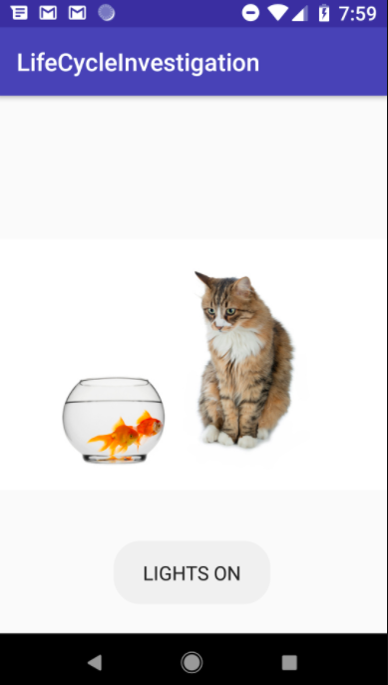
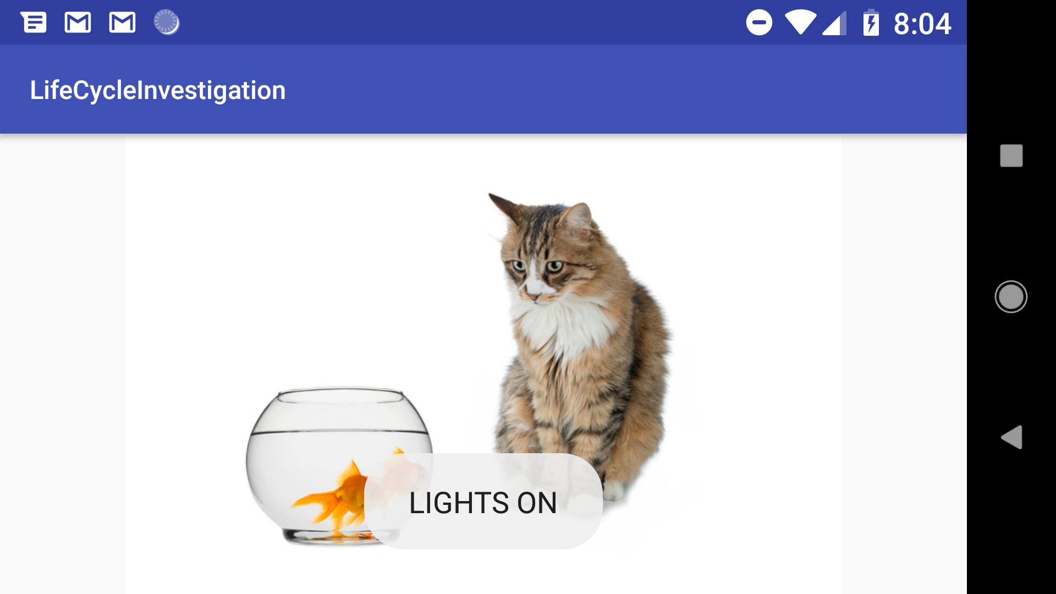
POJOs can be life cycle aware
You can make any class react to lifecycle events
In these pictures, the Toast is created by a plain old Java class when app starts or device rotates

Slide 81
Adding lifecycle awareness to a POJO
public class Aquarium {
// Constructor takes Application and lifecycle
public Aquarium(final Application app,
Lifecycle lifecycle) {
...
}
Notes:
Here we turn a Plain Old Java class into a lifecycle aware class

Slide 82
Constructor for lifecycle aware POJO
public Aquarium(final Application app, Lifecycle lifecycle) {
// Add a new observer to the lifecycle.
lifecycle.addObserver(new LifecycleObserver() {
@OnLifecycleEvent(Lifecycle.Event.ON_START)
public void start() {
Toast.makeText(app, "LIGHTS ON", Toast.LENGTH_SHORT).show();
}
});
}
Notes:
Here we turn a Plain Old Java class into a lifecycle aware class

Slide 83
Creating an instance
public class MainActivity extends AppCompatActivity {
private Aquarium myAquarium;
protected void onCreate(...) {
...
// Create aquarium.
// Pass context and this activity's lifecycle
myAquarium = new Aquarium(this.getApplication(),
getLifecycle());
}
}

Slide 84
What's next?
Concept chapter: 10.1 Room, LiveData, and ViewModel
Practical: 10.1A : Room, LiveData, and ViewModel
Practical: 10.1B : Room, LiveData, and ViewModel

Slide 85
END

